Slide 1
Perception and the Senses

Slide 2
Big Questions
How many megapixels are our eyes? How awesome are our other senses?
Sensation: the physical sensors
Is perception veridical, or just a convenient illusion? Is it a hard problem? How does it work?
Perception: internal encoding of sensory inputs into meaningful patterns
Illusions: reveal the tricks our brain uses..

Slide 3
5+2 senses
Modality | Stimulus | Receptors | Thal -> Cortex | Absolute threshold
Vision (sight) | Light (photons) | Rods & Cones in Retina | LGN -> V1 | Candle flame from 30 miles (on clear night)
Audition (hearing) | Sound (variation in air pressure) | Hair cells in Cochlea | MGN -> V1 | Tick of watch at 20 feet (in a quiet room)
Olfaction (smell) | Airborne molecules | Hair cells in Olfactory epithelium | (none) -> Olfactory cortex | 1 drop of perfume diluted in air of 6 room house
Gustation (taste) | Food molecules | Taste Buds in Papillae | VPN -> Insula | 1 teaspoon of sugar in 2 gallons of water (try it!)
Somesthesis (touch) | Touch, pressure, temperature, pain | Free nerve endings in Skin | PMN, VPN -> S1 | Wing of a fly falling on cheek from 1cm
Proprioception (self movement) | Muscle stretch | Muscle Spindle fibers | VPS -> S1
Vestibular (balance) | Head rotation, acceleration | Semicircular Canals & Otoliths | VPN -> S1

Slide 4
Psychophysics
Absolute threshold
Lowest level of stimulus intensity for 50% response
“How low can you go?”
Just-noticeable difference (JND)
Difference in stimulus intensity for 50% response
“Ch Ch Ch.. Changes”
Weber’s law: JND proportional to stimulus intensity
Easier to tell small weight diff between two light objs, vs. two heavy

Slide 5
Signal Detection Theory
Signal
Present
Absent
Yes
Hit
False Alarm
Response
Correct
Rejection
No
Miss

Slide 6
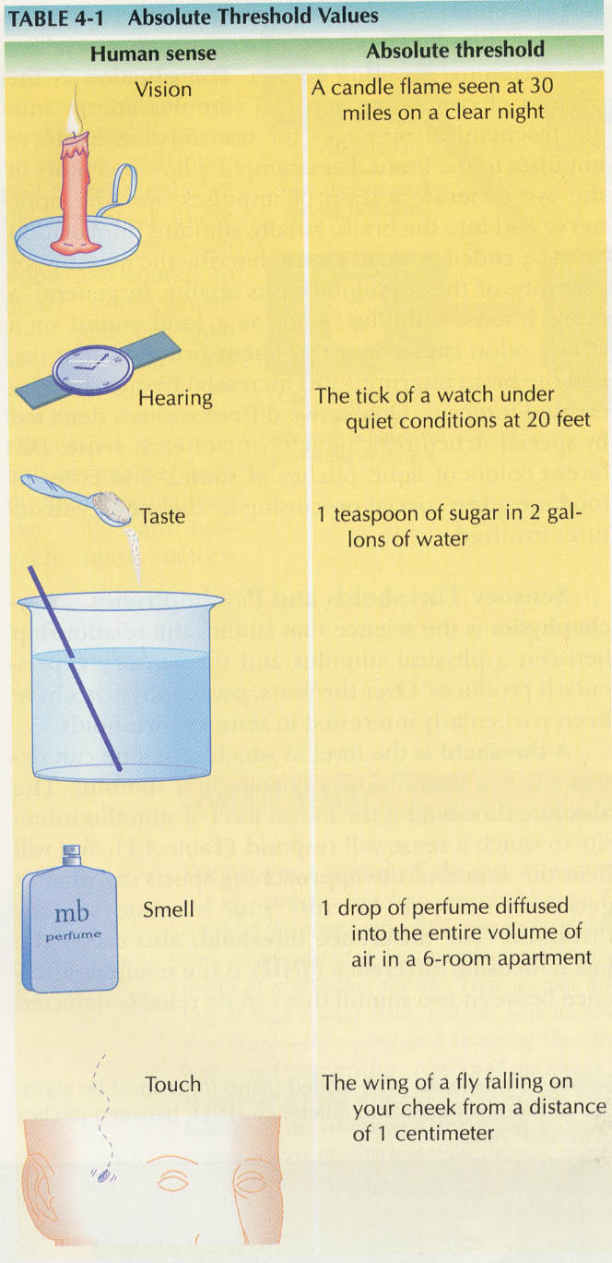
We’ve got a pretty kick-ass set of senses!

Slide 7
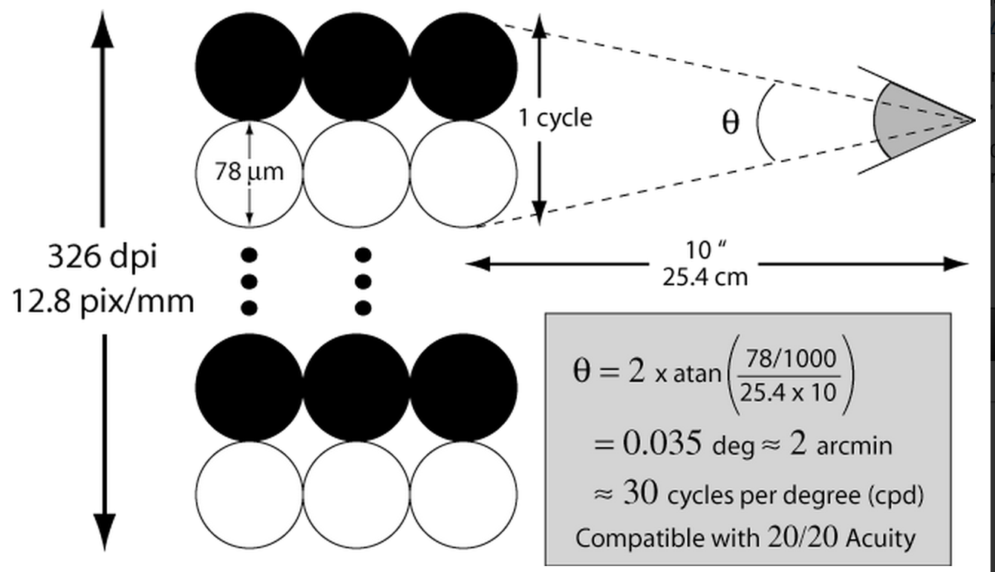
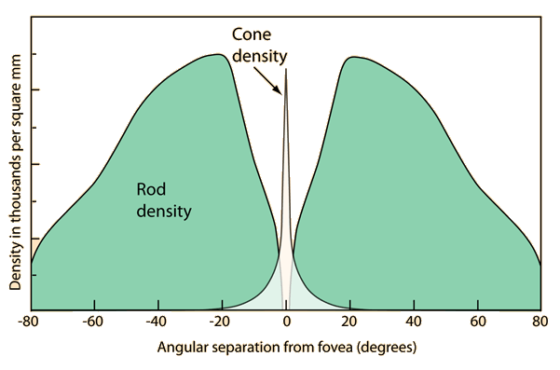
How Many Megapixels??
Retina has ~100 mega-rods, only ~5-7 mega-cones
Fovea can resolve about 30 cycles-per-degree (requires cone spacing of ~.3 arcmin) = ~300 dpi at 10” (close!)
Focal length of human eye is ~22mm, max ISO about 800

Slide 8
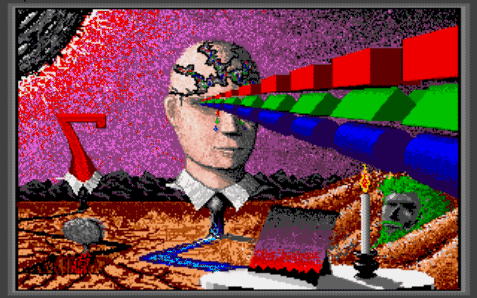
Perception: Open Them Doors!
Perception opens the door to illusion, as well as truth, sadness, and other strange things..

Slide 9
How Does it Work?
CCC = Contrast!
Light/dark, color, time (adaptation)
just tell me the news!
Ass + u + me = visionary!
The brain has to make many (learned) assumptions based on “normal” visual inputs
CCC = Compression: reduce input to simple, high-level description: we see “things”, not stimuli
Easy to trick it with improbable coincidences..

Slide 10
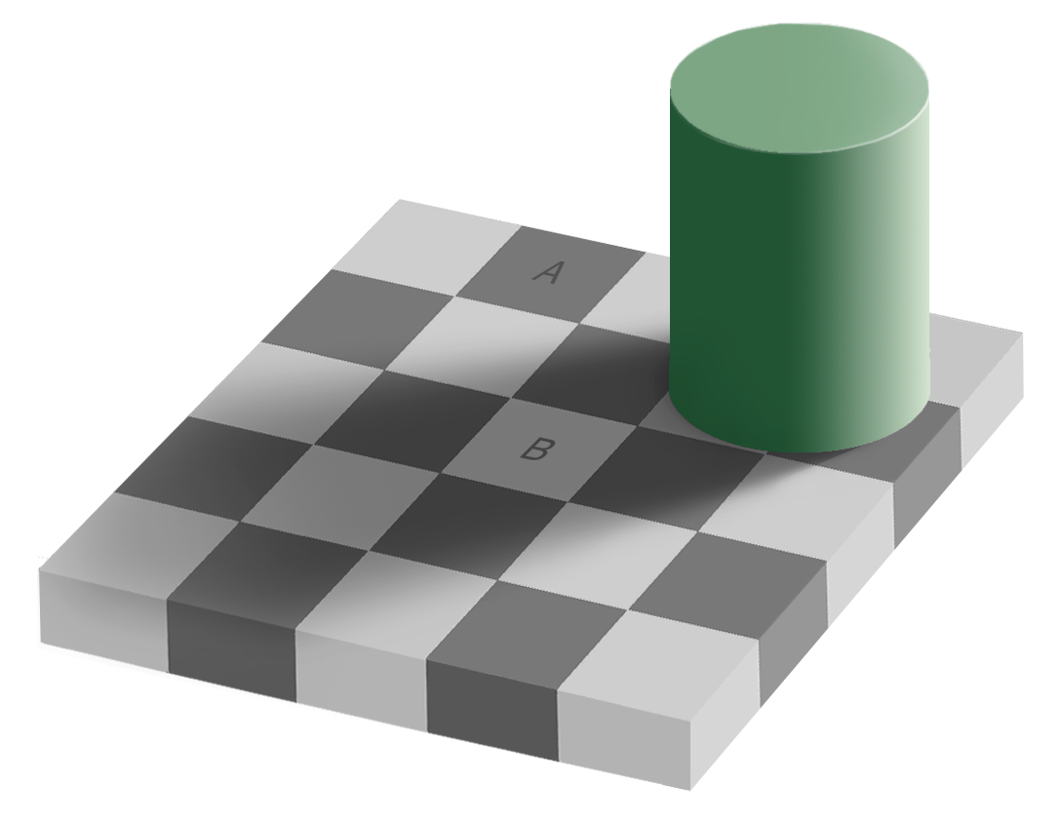
Contrast Illusions
A = B??
Clicker:
A. A != B
B. A = B

Slide 11
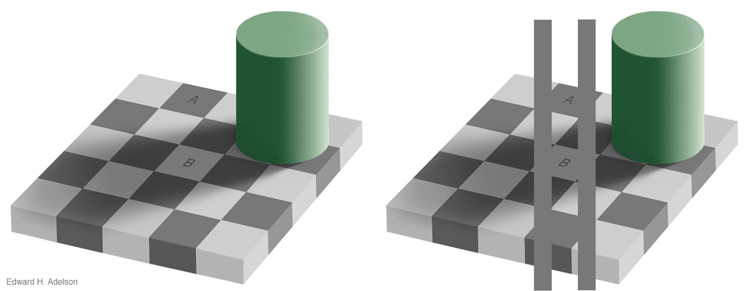
Contrast Illusions
A = B??
No Way!
Way!

Slide 12
Color Contrast
https://www.youtube.com/watch?v=gur-_IGV7F8

Slide 13
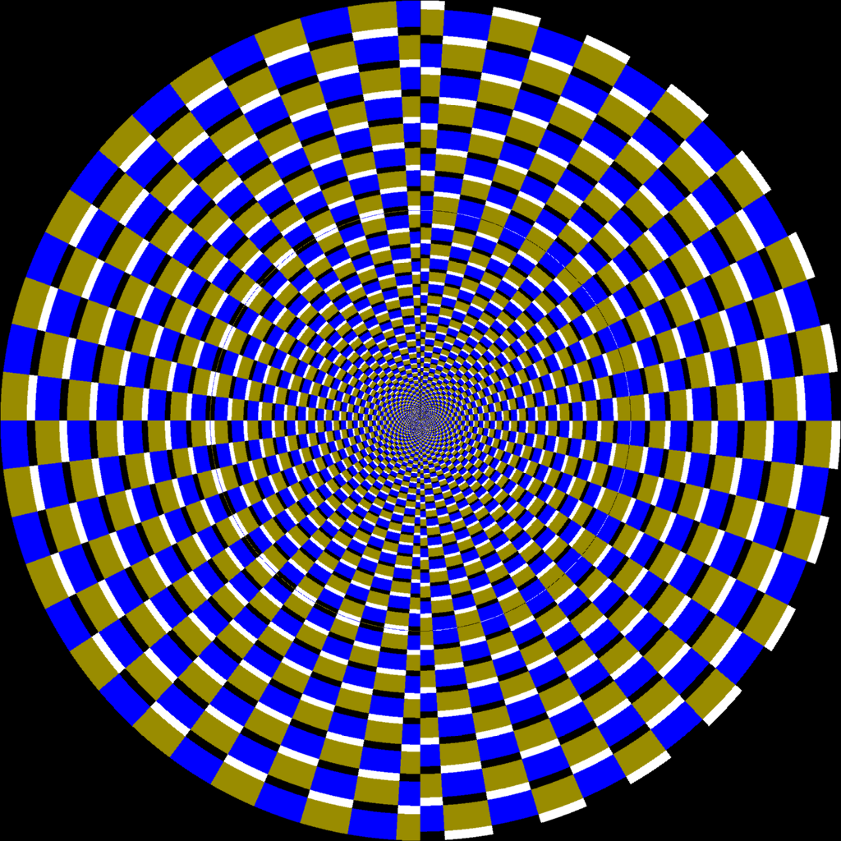

Slide 14
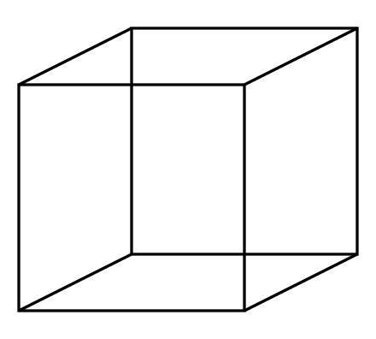
Time Contrast (we have a model of this)
Click it:
A. Up-right
B. Down-left

Slide 15
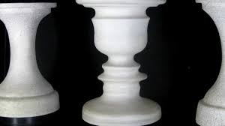
Time Contrast

Slide 16
The Brain Makes Assumptions
https://www.youtube.com/watch?v=m86ae_e_ptU
And these assumptions can be violated..
Key point: eyes only provide a tiny window onto the full 3D world – we need the assumptions to make sense of what we’re seeing
CCC = Compression: making sense = compressing entire sensory input into something simple like “a dog under some trees”

Slide 17
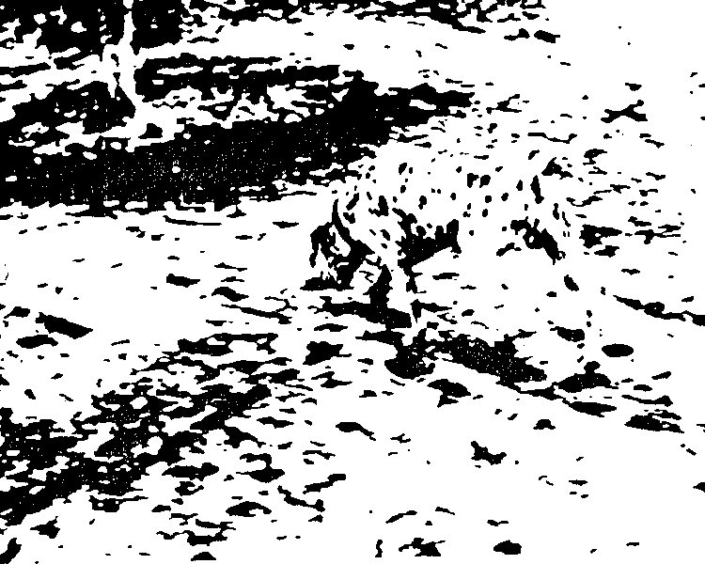
We Think in Categories
(much easier than disconnected pixels..)

Slide 18
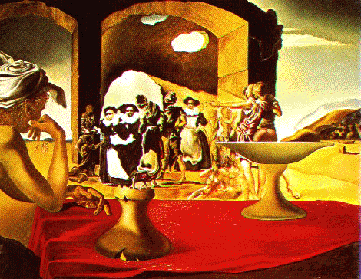
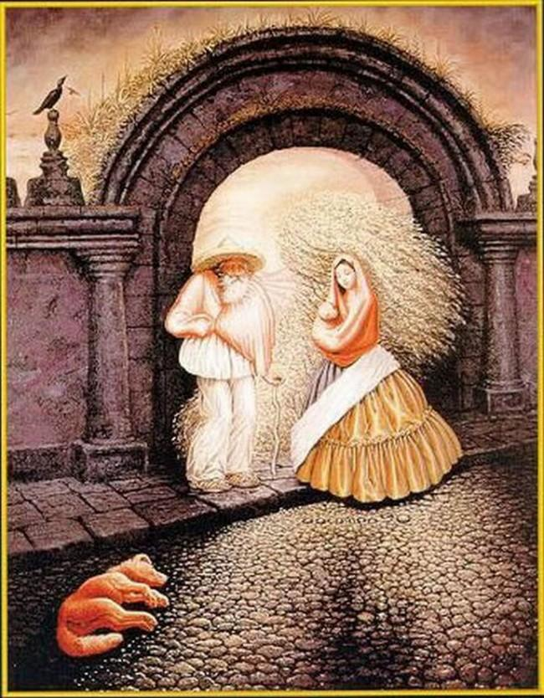
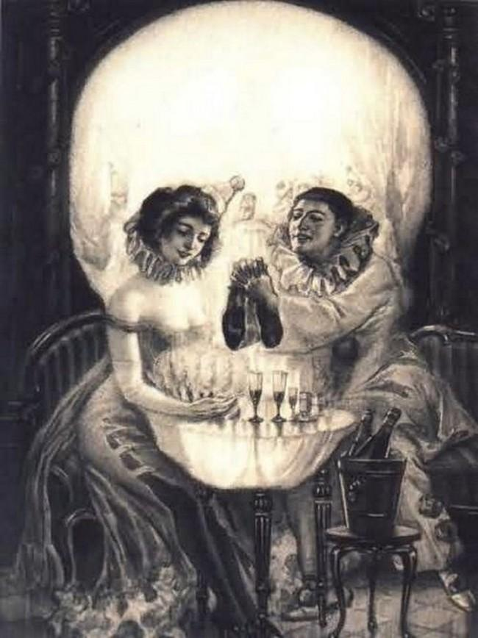

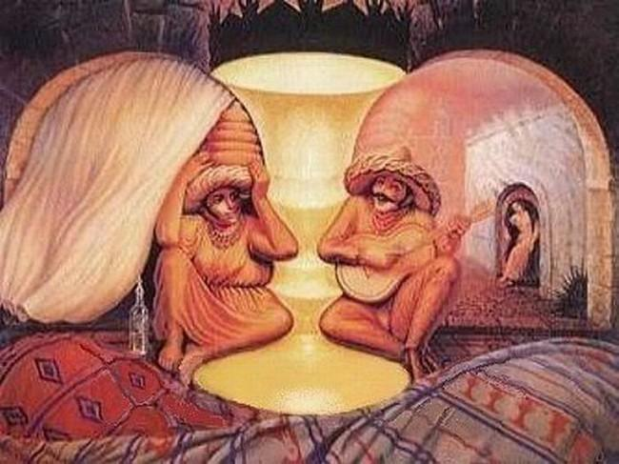
Dali!

Slide 19
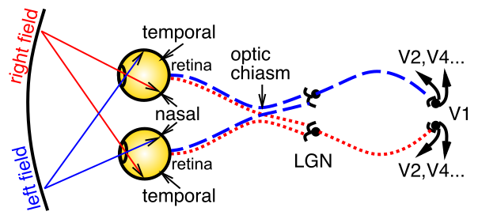
The First Sense: Vision
Light goes through pupil, size of which controlled by iris, lens focuses on retina, containing rod (fast, b/w) and cone (slow, color) photoreceptors. LGN = thalamus, V1 = primary visual cortex.

Slide 20
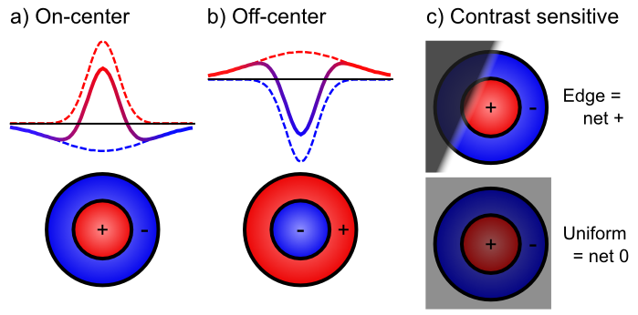
Retinal Contrast Filtering

Slide 21
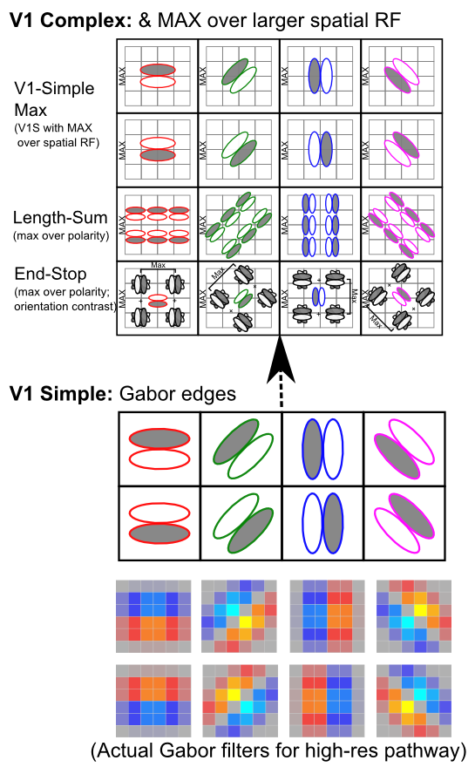
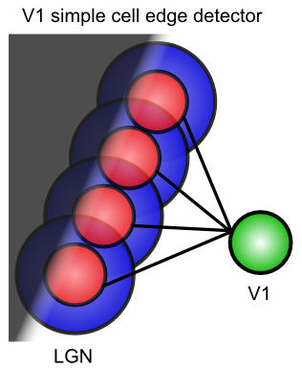
V1

Slide 22
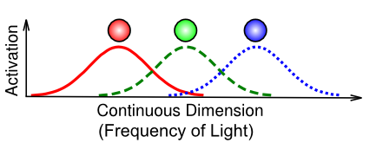
Trichromatic Color Vision
Color opponent process theory:
red vs. green,
blue vs. yellow
black vs. white (achromatic)

Slide 23
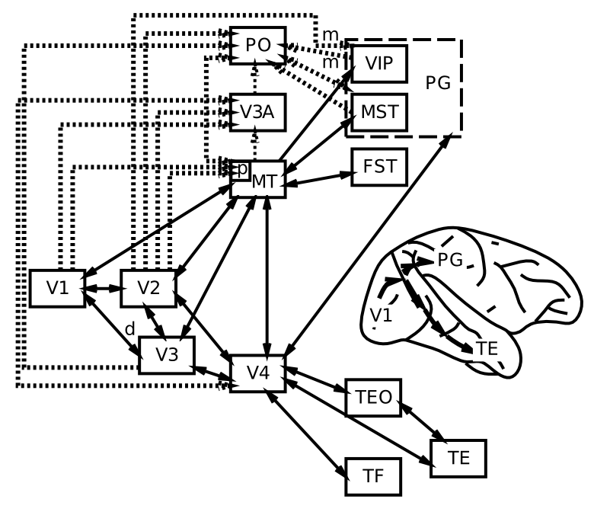
Visual Hierarchy: What vs Where

Slide 24
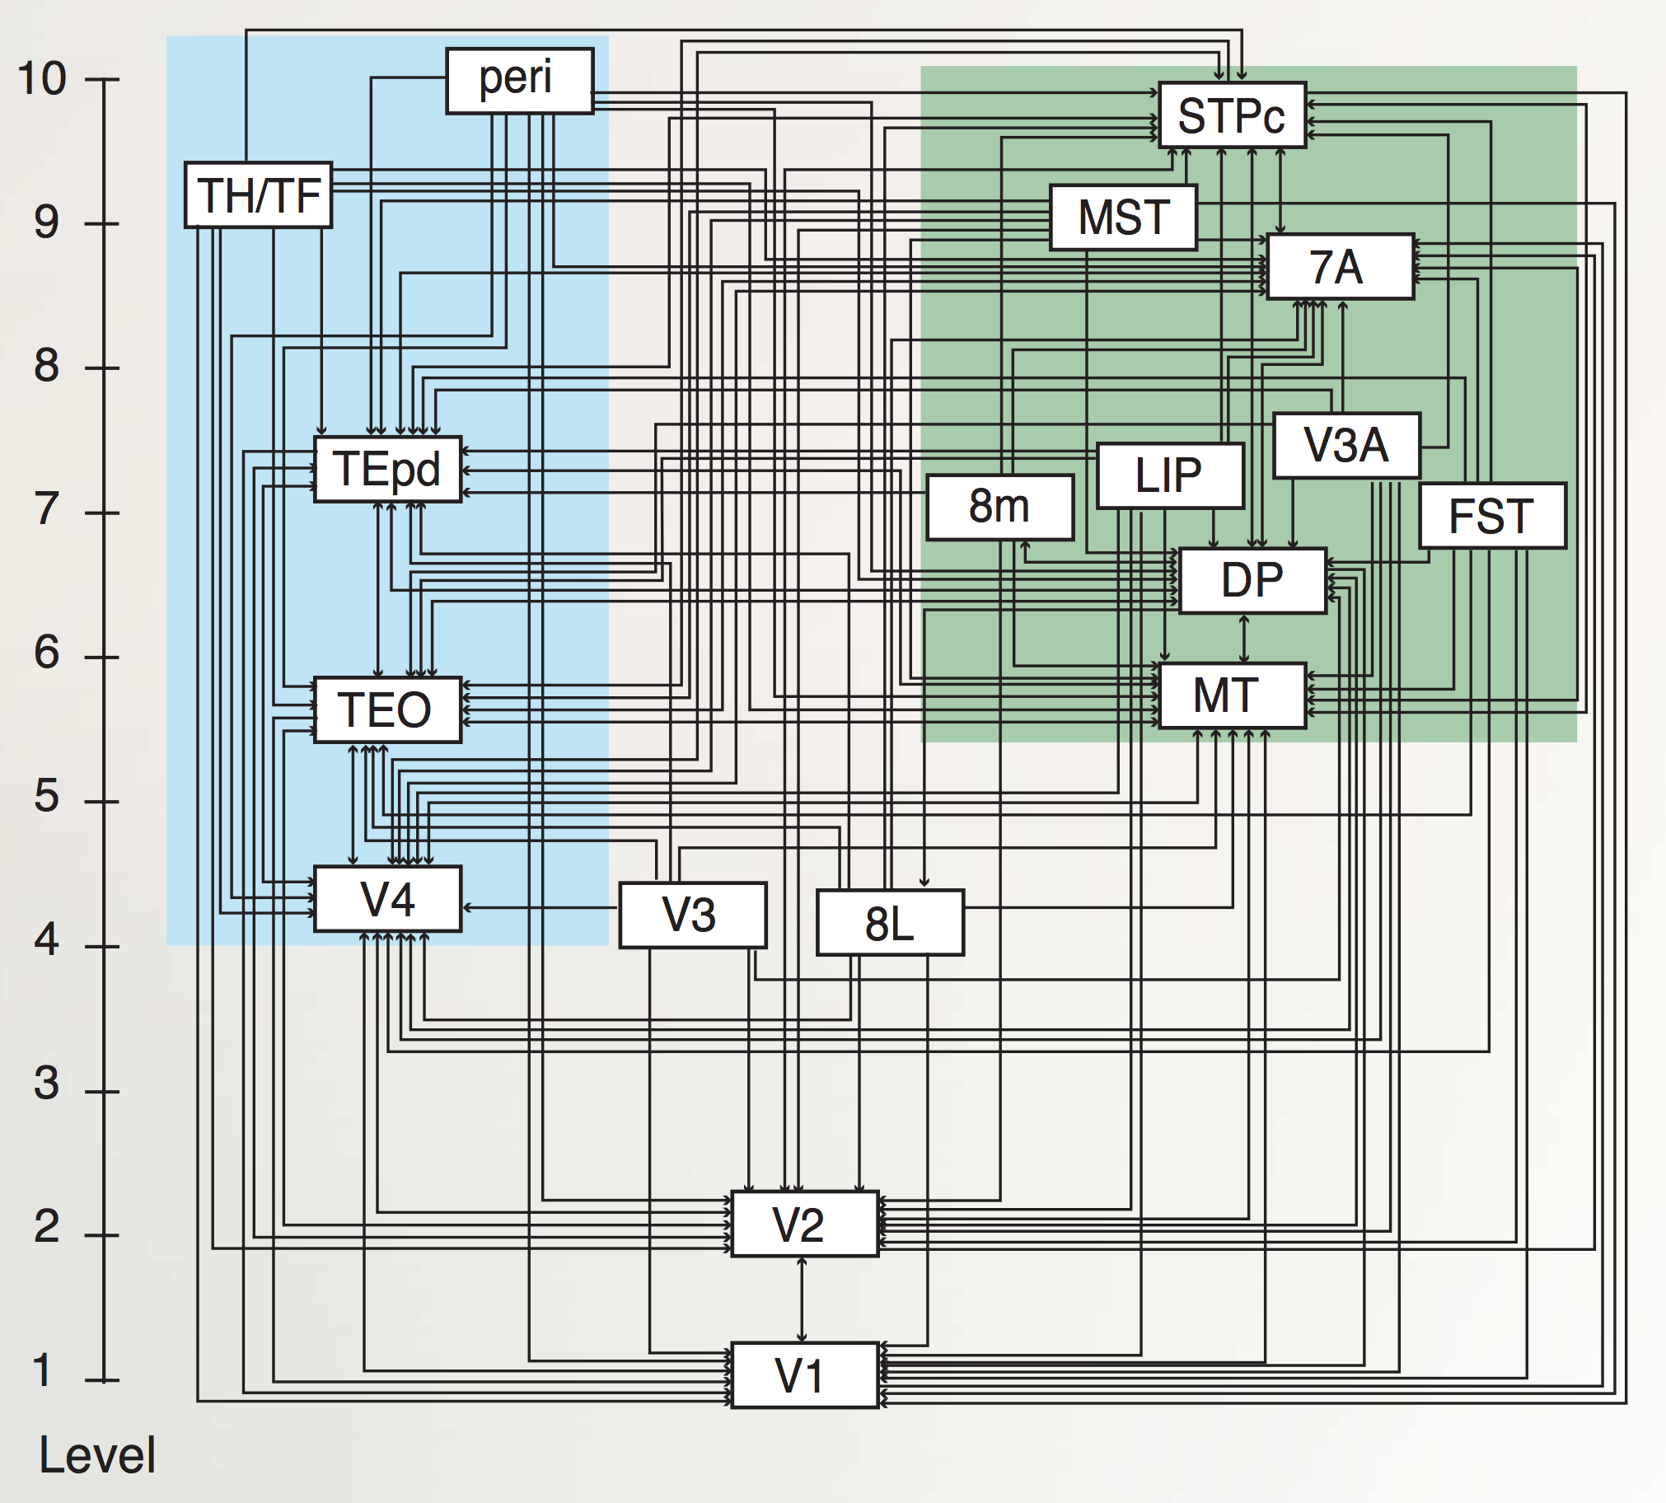
“Van Essen” Hierarchy
TE.. = Temporal
LIP, DP.. = Parietal
8L = Frontal Eye Field
To hippocampus:
TH/F = Parahippo
peri = Perirhinal
Markov et al., 2014

Slide 25
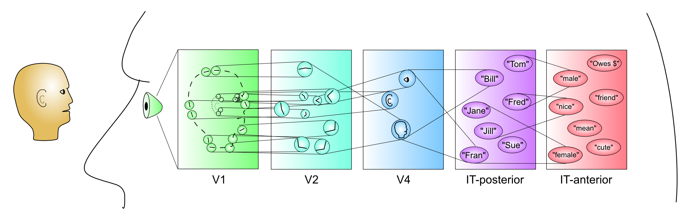
Hierarchy of Detectors..
Each stage builds set of assumptions based on typical environmental input
Shape from shading
Depth cues: occlusion, texture, etc

Slide 26
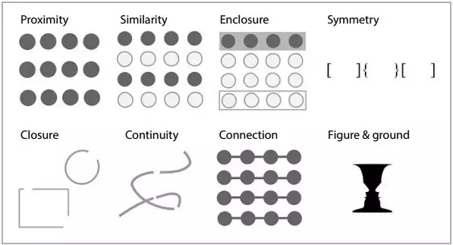
Gestalt Principles

Slide 27
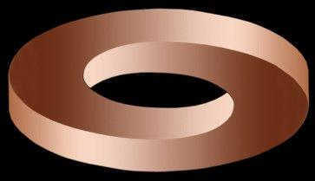
Shape from Shading

Slide 28
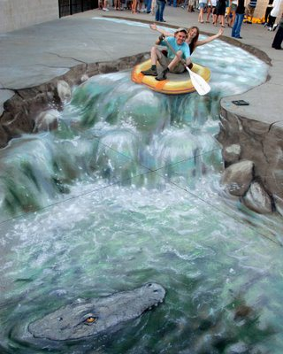
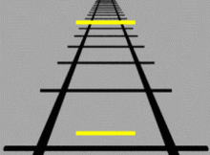
Monocular Depth Cues
Linear Perspective, relative size, interposition (blocking), horizon position
Binocular: retinal disparity, convergence

Slide 29
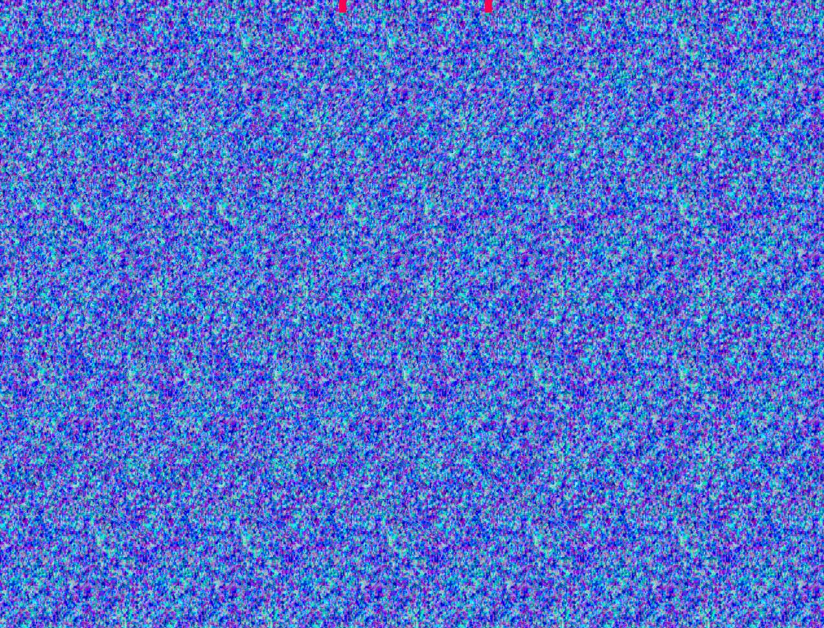
Binocular Disparity = 3D

Slide 30
Constancy: CCC = Compression
We see a world full of “things”, not “stimuli” or “pixels”
Constancy = “seeing the thing” not the stimulus
Size Constancy = see human as human sized regardless of actual size in the image
Except if you have Alice in Wonderland Syndrome

Slide 31
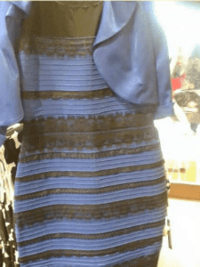
Breakdown in Color Constancy
Click it:
A. Blue and Black
B. White and Gold
C. Blue and Brown

Slide 32
Is Perception Veridical? No..
Perception is a construction of high-level abstractions from limited data – not veridical
Experience-based learning plays a critical role in shaping perception
Cultural, language effects: Muller-Lyer illusion
Also, top-down expectations and attention!
http://www.theinvisiblegorilla.com/videos.html

Slide 33
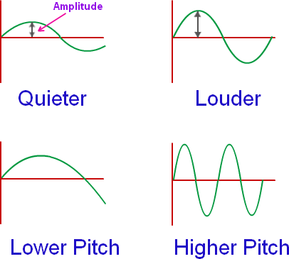
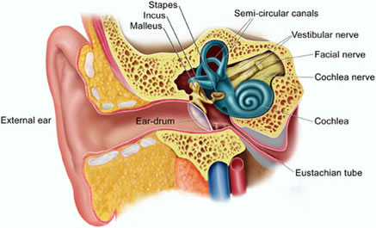
Audition
Basilar membrane: retina of the ear, located in cochlea
hair cells transduce sound, location along membrane = frequency
(place theory), except low-frequency = direct firing rate (frequency theory)
Interaural time / level differences = auditory localization

Slide 34
Olfaction, Taste, Touch
Olfactory receptors detect chemicals, including pheromones; olfactory bulb -> piriform cortex
Taste buds: sweet, salty, sour, bitter, umami?, fatty? -> insula cortex
Tactition: “touch” – mechanoreceptors, Thermoception: heat – thermoreceptors, Nociception: pain – A-delta (first), C-fibers (second) -> somatosensory cortex
CU: Chris Lowry: warmth -> serotonin happy cells

